Slide 1


LIVESTOCK-TRADE
Business model canvas

Slide 2
Project team members
1. Kitauka Innocent
2. Sijali Madikah
3. Nkeshimana Carmel
4. Japheth Mumo

Slide 3
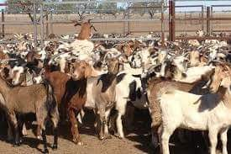
livestock trade competitors
Local market
Local market blocker
Online market
Business to Customers.
ie National Horticultural Market
Information System, (NaHMIS)

Slide 4

PROJECT OUTCOMES
Time management
Cost management
Resource management
End-to-end information Encryption
Combination are to reduce information
asymmetries and improve market efficiency,
increasing access to information, markets,
finance and contributing to improving governance within the livestock sector

Slide 5
THE END

